Slide 1
Estructura
Product
Owner
Data
engineer
UX
Data
Scientist
ML Engineer
Data
Analysts
Scrum Master
Product
Improvement

Slide 2
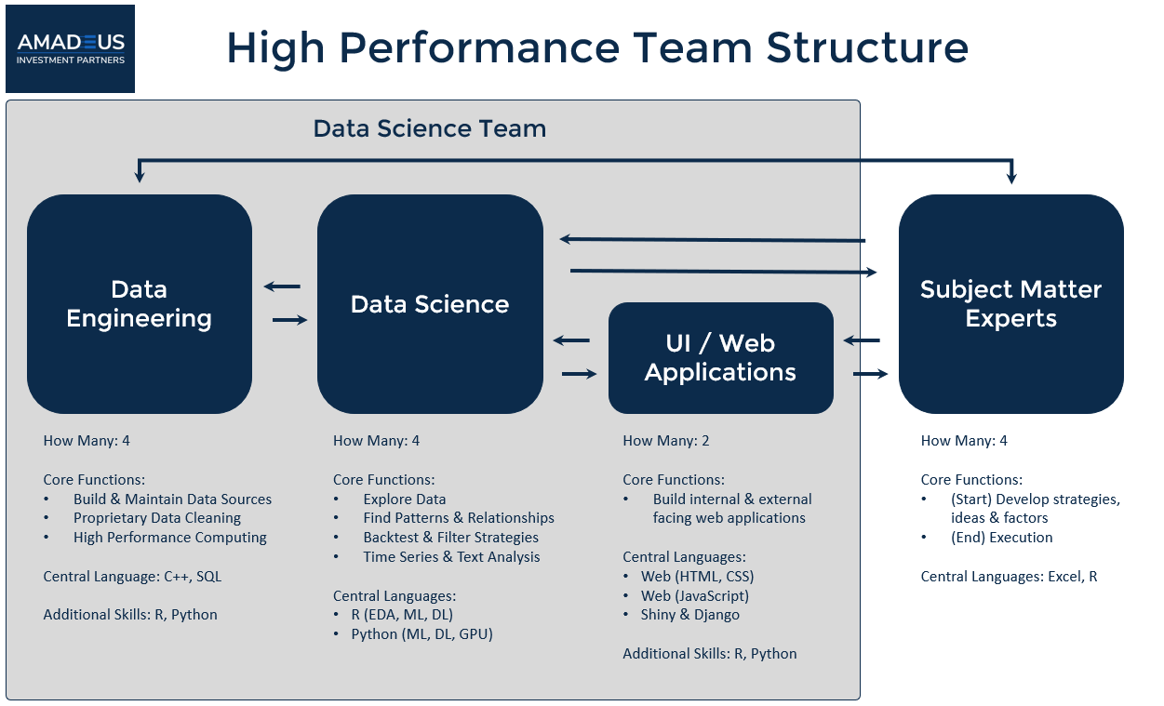
Célula de datos
Data Science Team
Data
Engineering
Data
Science
Subject Matter Experts
UI/ Web Applications

Slide 3
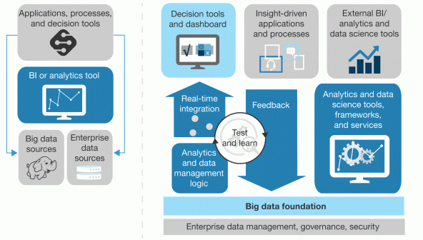
Data driven approach
Insinght driven approach
Applications, processes, and decision tools
Decision tools and dashboard
Insight-driven applications and processes
External BI/ analytics and data science tools
BI or analytics tool
Real-time
integration
Feedback
Analytics and data science tools, frameworks, and services
Test
and learn
Big data
sources
Enterprise
Data sources
Analytics
and data
management
logic
Big data foundation
Enterprise data management, governance, security
Descubrimos que, si bien el 74% de las empresas dicen que quieren estar "impulsadas por datos", solo el 29% dice que son buenas para conectar el análisis con la acción. Ese es el problema. Forrester

Slide 4
Las organizaciones deben enfocarse en un esquema de procesos Liderados por datos
Datos alternativos
IA ética
&
UX for IA
Cloud computing
distribuido
Blockchain
Agilidad y gobierno
Insight Driven
Company
Hiper
automatización
Decisiones en tiempo real
Democratización
NBA
Democratización
Operacionalización
de los datos

Slide 5
UX of AI
Empatizar con
el mundo del cliente
Data Thinking
Canvas Machine learning model
Canvas chatobots
Canvas ethical AI
IA Ethical
Modelos sin sesgos
AI-RFX
Testing
Pruebas unitarias
Ciencia de datos
Feedback al cliente y
retroalimentación de los modelos
Aprendizaje activo
Advisor dashboard
Logs
Utilizar KPIs
Model Serving
and
Monitoring
Explainble IA
Model
&
data versioning
Models explicable
XAI
Modelos reproducibles
ModelDB
Operacionalización/
automatización
Reproducible
Privacy
preserving
ML
Automatización de
los procesos
MLOps
Test unit de los códigos
DataOps
Estandarización
de códigos, plantillas y
políticas de código
Enviroment
Notebooks
Versionamiento
Preservar la privacidad en todo momento
Anonimización
Seguridad de los modelos
AI Governance
Alternative Data

Slide 6
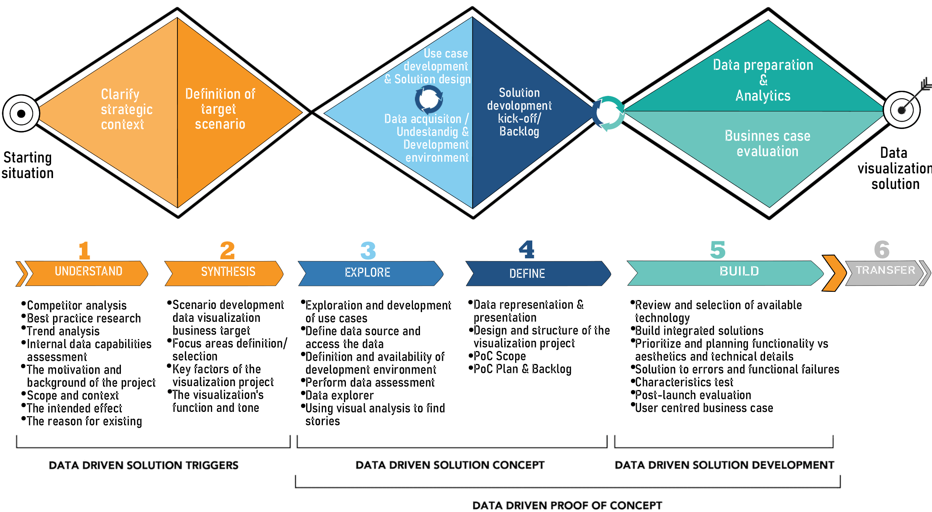
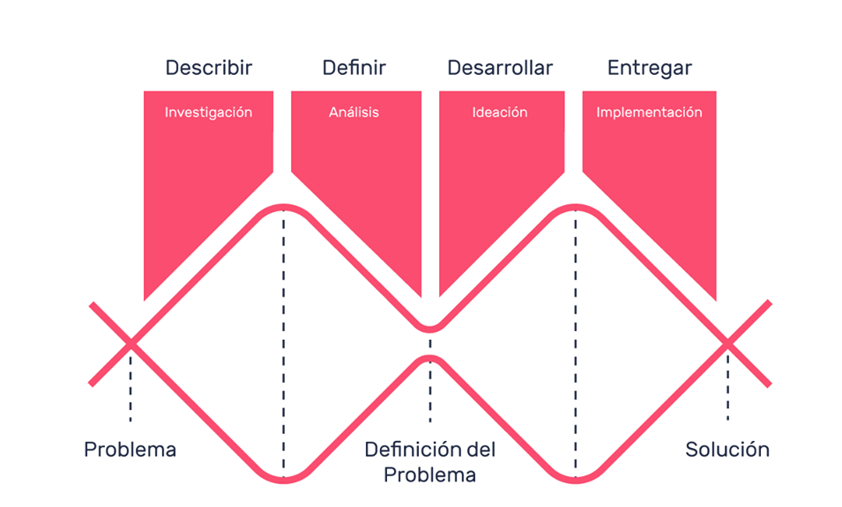
Use care development & Solution design
Data acquisition/ Undertandig & Development environment
Clarify strategic context
Definition of target scenario
Solution
Development
kick-off / Backlong
Data preparation
& Analytics
Businnes case evaluation
DATA DRIVEN SOLUTION TRIGGERS
DATA DRIVEN SOLUTION CONCEPT
DATA DRIVEN SOLUTION DEVELOPMENT
DATA DRIVEN PROOF OF CONCEPT
1
2
3
4
5
6
UNDERSTAND
SYNTESIS
EXPLORE
DEFINE
BUILD
TRANSFER

Slide 7
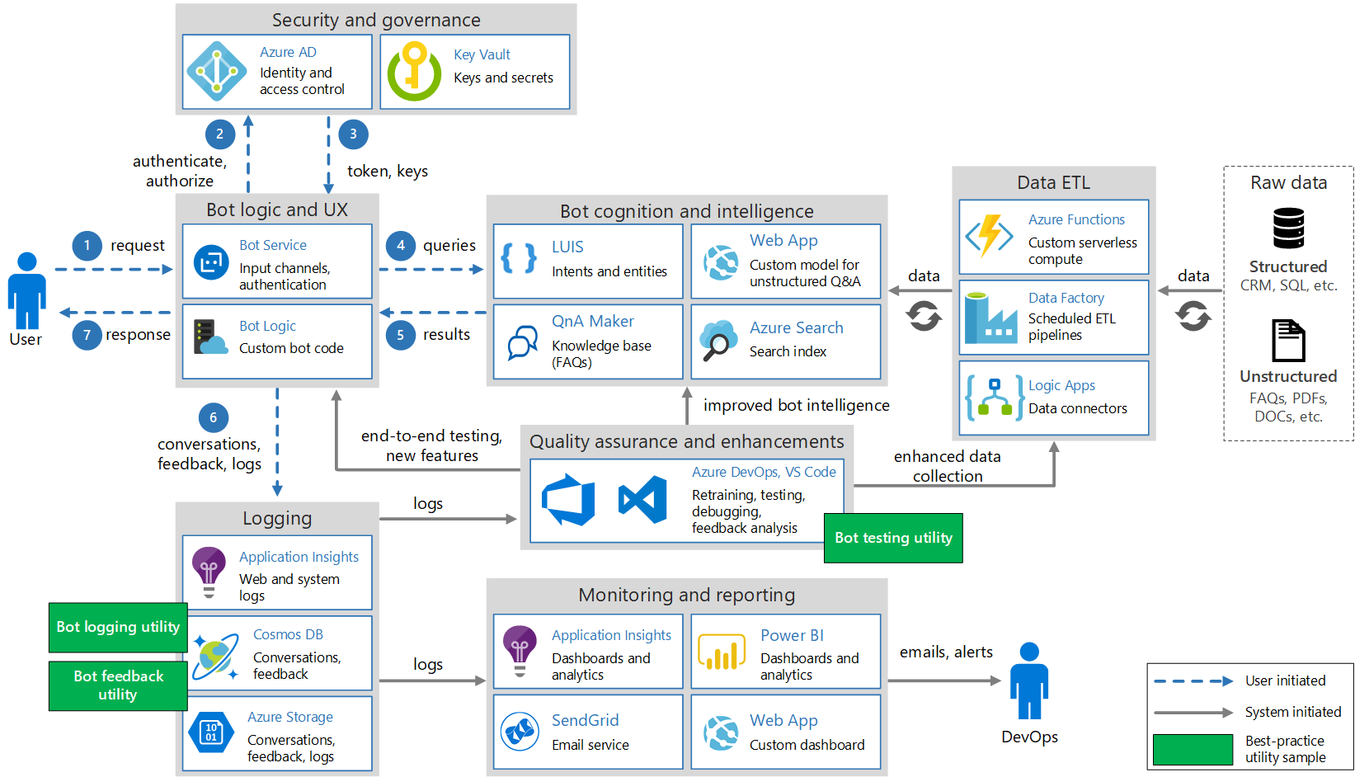
Security anf governance
2
3
Authenticate, authorize
Token, keys
Data ETL
Raw data
Bot cognitionand intelligence
Bot logic and UX
1
Request
4
Queries
Structured
CRM, SQL, etc
Data
Data
User
5
Results
7
Response
Unstructured
FAQs, PDFs, DOCs, etc.
6
Improved bot intelligence
Conversations, feedback, logs
End-to-end testing, new features
Enhanced data
collection
Quality assurance and enhancements
logs
Logging
Bot testing utility
Monitoring and reporting
Bot logging utility
User initiated
System initiated
Best-practice
Utility sample
logs
Emails, alerts
Bot feedback utility
DevOps

Slide 8
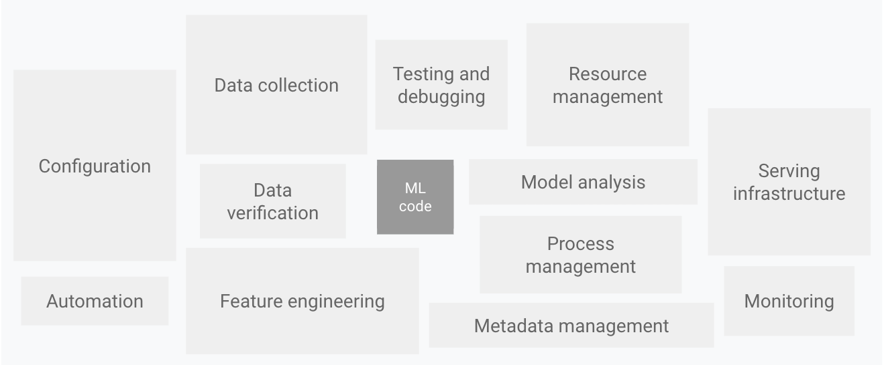
Data collection
Testing and debugging
Resource management
Configuration
Serving
infrastructure
ML
code
Model analysis
Data verification
Process management
Automation
Feature engineering
Monitoring
Metadata management

Slide 9
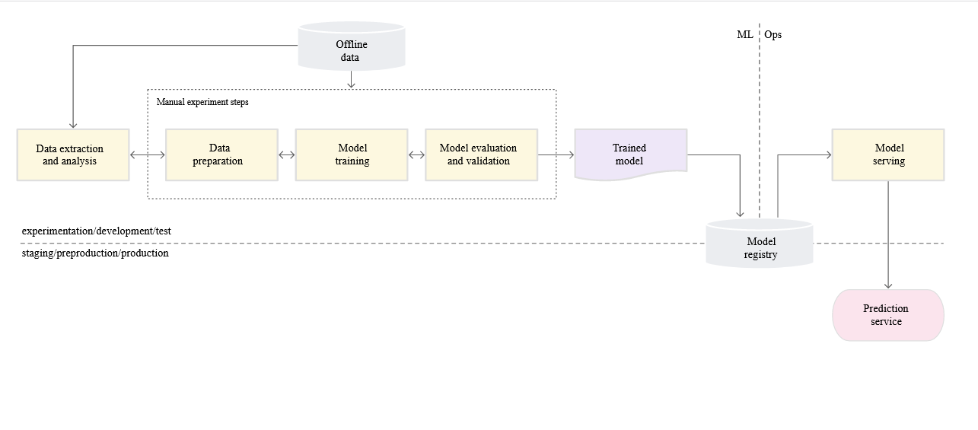
Offline data
ML Ops
Manual experiment steps
Data extraction and analysis
Data preparation
Model training
Model evaluation and validation
Trained model
Model serving
Model registry
Experimentation / development
Prediction
service
Staging / preproduction / production

